Slide 1


Oracle database
Lecture 20

Slide 2

Today’s Agenda
SubQueries
Types Of SubQueries
Single Row SubQuery
Multi Row SubQuery

Slide 3
Introduction To SubQuery
Definition: A subquery is a SELECT statement nested inside another statement such as SELECT, INSERT, UPDATE, or DELETE
Purpose: Many times when we write a query in Oracle ,we might want to compare a column or expression with the result of another query.
It happens when we don’t know the exact value with which this comparison will be done but we know the query that will generate this value. This is where we use SUBQUERIES

Slide 4
General Syntax Of A SubQuery
Syntax:
Select <list_of_cols>
From <table_name>
Where <col_name> <operator>(Select <col_name> From <table_name> where <test_cond>);
Points To Remember:
Subqueries must always be nested within parenthesis
We can have this nesting up to 255 levels
In a simple subquery, the inner query is executed once, before the execution of the outer query.

Slide 5
Types Of SubQuery
Oracle supports 4 types of subqueries which are:
Single Row Subquery
MultiRow Subquery
Corelated Subquery
MultiColumn Subquery

Slide 6
Single Row SubQuery
If the subquery returns a single value then it becomes a SINGLE ROW SUBQUERY .
In such cases the WHERE clause of outer query can contain only SINGLE VALUED OPERATORS like =,!=,>,<.,>=,<=.

Slide 7
Multi Row SubQuery
Multi Row SubQueries are those where the inner query generates multiple values .
In such case we cannot use SINGLE VALUED OPERATORS in the WHERE clause of outer query , otherwise Oracle will give syntax error.
So , for Multi Row Subqueries , Oracle provides us MULTI VALUED OPERATORS for comparison and these are in ,any , some and all.

Slide 8
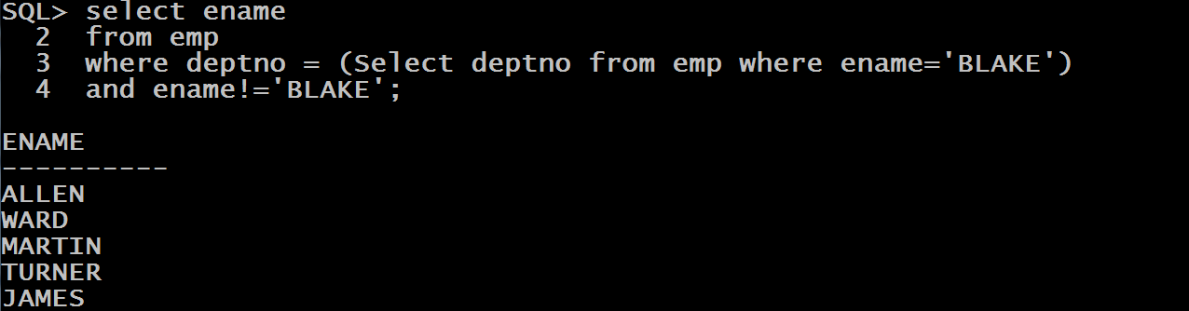
Query
WAQ to display the names of all the employees who work in same department as BLAKE.

Slide 9
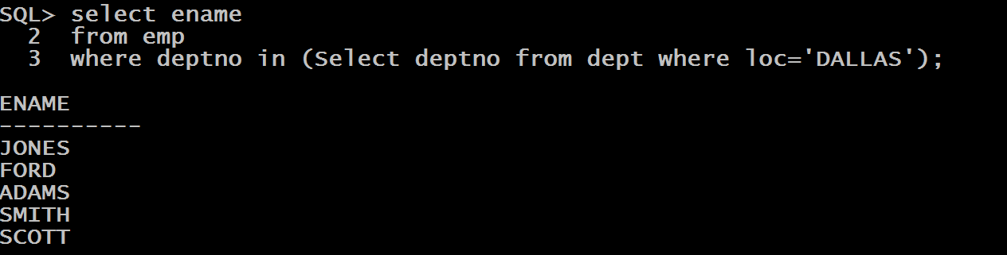
Query
WAQ to display the names of all the employees who work in the city of DALLAS.

Slide 10
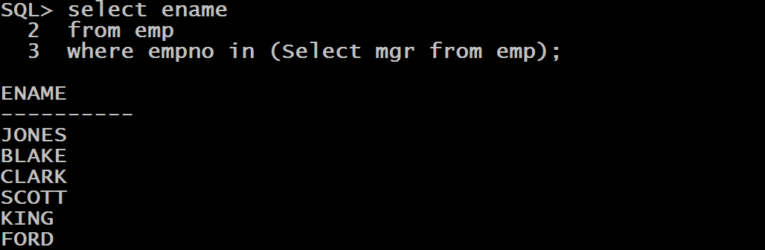
Query
WAQ to display the names of all the employees who work as managers.

Slide 11
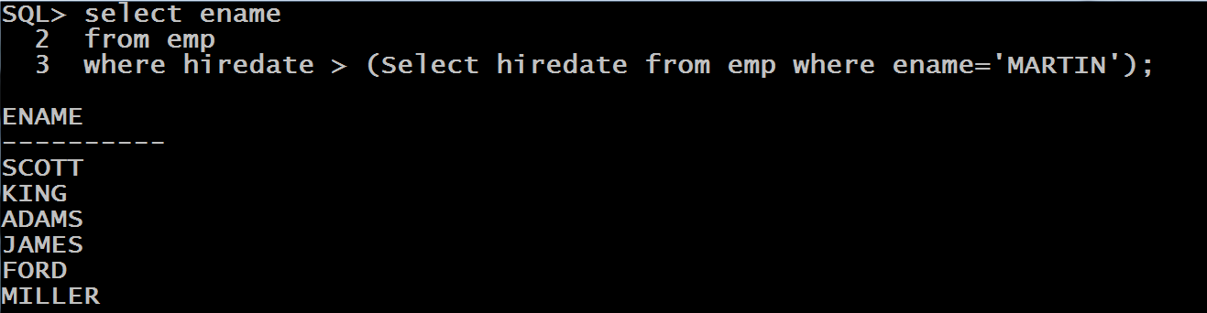
Query
WAQ to display the names of all the employees who were hired after MARTIN.

Slide 12
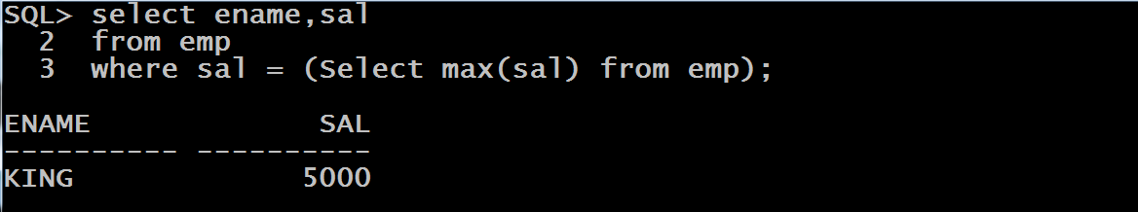
Query
WAQ to display the names and salary of all the employees who earn the highest salary.

Slide 13
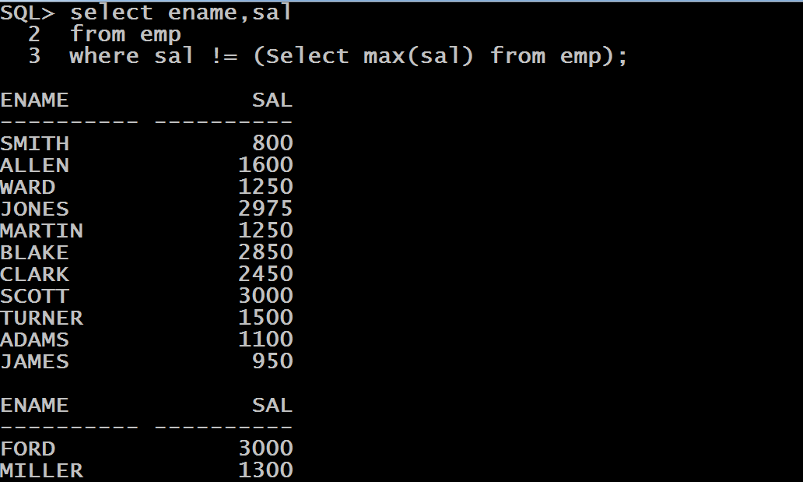
Query
WAQ to display the names and salary of all the employees who do not earn the highest salary.

Slide 14
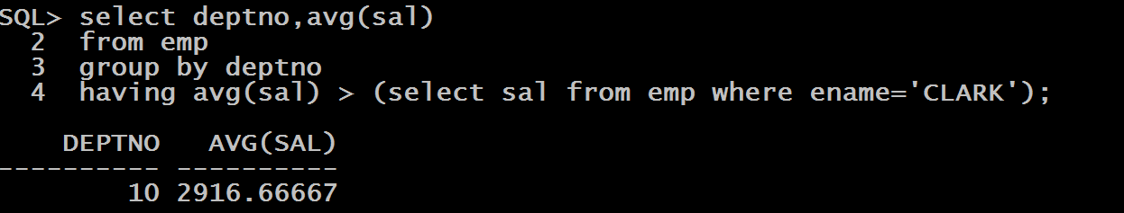
Query
WAQ to display those deptno with their average salary whose average salary is greater than the salary of CLARK.

Slide 15
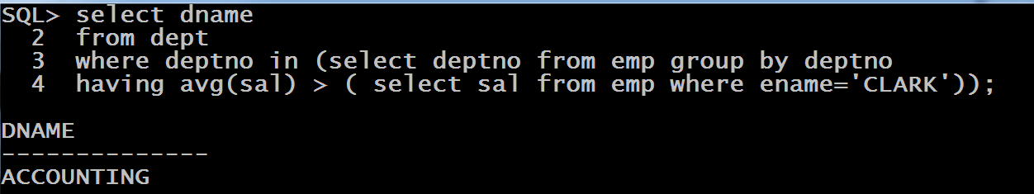
Query
Modify the previous query to display the deptname instead of deptno

Slide 16
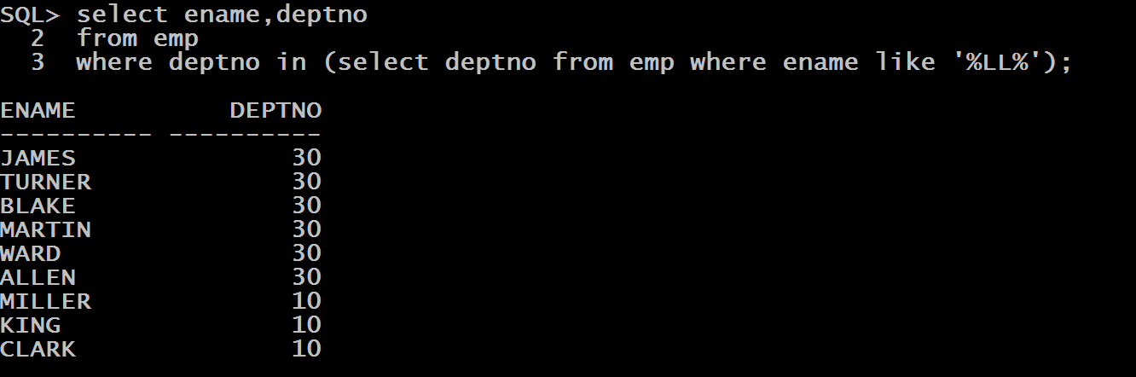
Query
WAQ to display the name and deptno of all the employees whose colleagues have two LL in their names

Slide 17
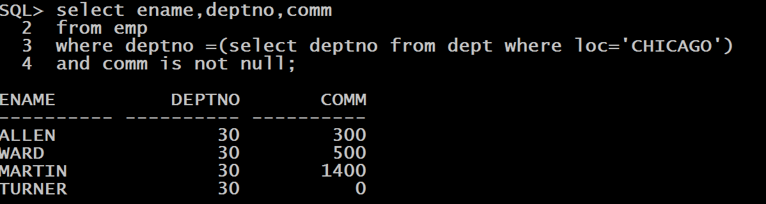
Query
WAQ to display the name of all the employees who work in CHICAGO and they get a commission.

Slide 18
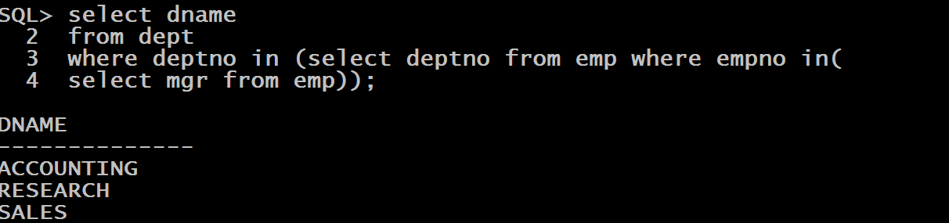
Query
WAQ to display the names of all the departments whose employees are managers.

